Slide 1
DevOps Certifications Guide
SE489: DevOps Engineering

Slide 2
Introduction
The ability for DevOps professionals to prove their expertise isn’t always straightforward.
Obtaining a DevOps certification is one way for employees and potential job candidates to validate and demonstrate their skills, offering a competitive edge over others vying for the same positions.
This is a complete guide on DevOps certifications including some of the top DevOps certifications currently in demand.

Slide 3
What is a DevOps certification?
A DevOps certification is a designation that demonstrates specific competency or expertise in skills and subject matter that are needed in order to be a successful DevOps professional.
You can typically earn these various certifications following any combination of:
Assessment or exam
Educational course
Performance review
Other ways to show that the candidate meets rigorous standards

Slide 4
Why should I consider a DevOps certification?
There’s no doubt about it: DevOps is here to stay.
The need to obtain a DevOps certification is no longer trendy—it’s quickly becoming a nonnegotiable.
Whether you are looking to enhance your current skill set, advance positions, or pivot in a different direction entirely, obtaining a DevOps certification comes with major benefits for both the company and the employee.
DevOps positions are consistently ranked among the highest paying salaries in the industry.

Slide 5
Top DevOps Certifications
Top DevOps Certificates
AWS Certified
Docker
Kubernetes
Azure DevOps
Puppet Certified
DevOps Institute

Slide 6
AWS Certifications

Slide 7
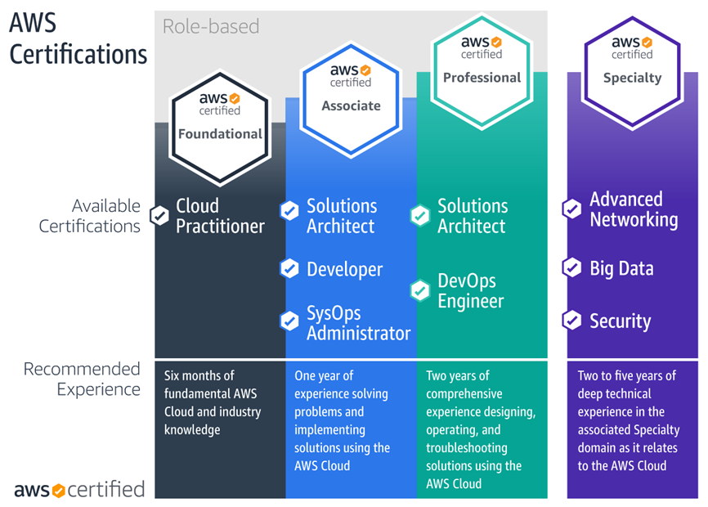
AWS Certifications

Slide 8
AWS Certified DevOps Engineer Professional
When it comes to DevOps, one of the first stops is Amazon Web Services.
AWS provides services that are built first for use with AWS and help companies facilitate DevOps.
Utilizing these tools help engineers to:
Automate manual tasks
Manage complex environments at scale
Control high velocity applications

Slide 9
AWS Certified DevOps Engineer Professional
The AWS Certified DevOps Engineer Professional certification is intended for individuals in a DevOps engineer role with 2+ years of experience provisioning, operating, and managing AWS environments.
Those who complete this certification will have expertise:
Implementing and managing continuous delivery systems and methodologies on AWS
Implementing and automating security controls, governance processes, and compliance validation
Defining and deploying monitoring, metrics, and logging systems on AWS
Implementing systems that are highly available, scalable, and self-healing on the AWS platform
Designing, managing, and maintaining tools to automate operational processes

Slide 10
AWS Certified DevOps Engineer Professional
The AWS DevOps Engineer Professional exam is 170 minutes long with 40-65 multiple choice questions.
The exam focuses on SDLC automation; configuration management and infrastructure as code; high availability, disaster recovery, and fault tolerance; incident and event response; monitoring and logging; and policies and standards automation.

Slide 11
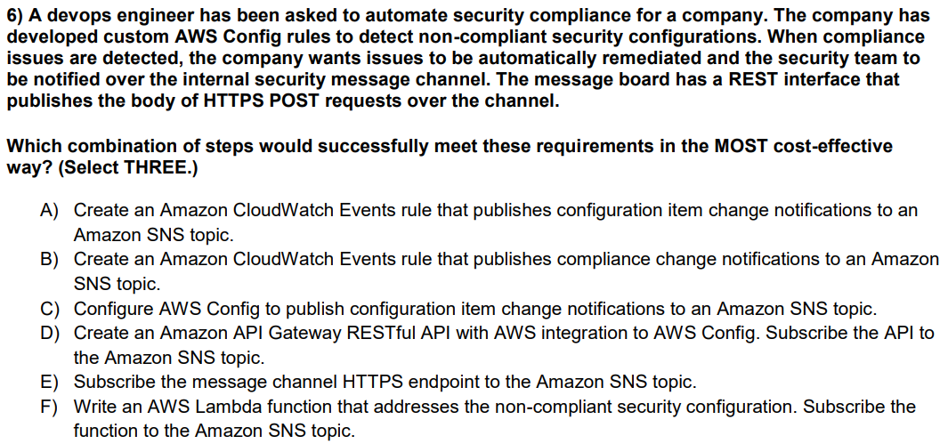

Slide 12
Docker Certified Associate

Slide 13
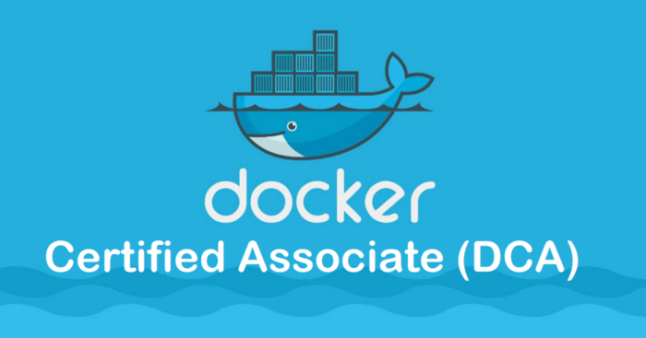
Docker Certified Associate (DCA)

Slide 14
Docker Certified Associate
The container management tool Docker is used in DevOps to manage software parts as isolated, self-sufficient containers that can be deployed and run in any environment.
In today’s job market, candidates with Docker skills are highly sought.
The Docker Certified Associate (DCA) certification is designed to validate that skillset with real world questions designed by experienced Docker practitioners.
As the first in a multi-tiered professional certification program, the DCA serves as a foundational benchmark for real world Docker skills across the container industry.

Slide 15
Docker Certified Associate
This certification course is ideal for Docker practitioners with 6+ months of experience.
The DCA exam is 90 minutes long and contains 55 multiple choice questions, proctored online.
The test covers the basics of a Docker ecosystem such as:
Orchestration
Security
Networking
Installation and configuration
Image creation
Management

Slide 16
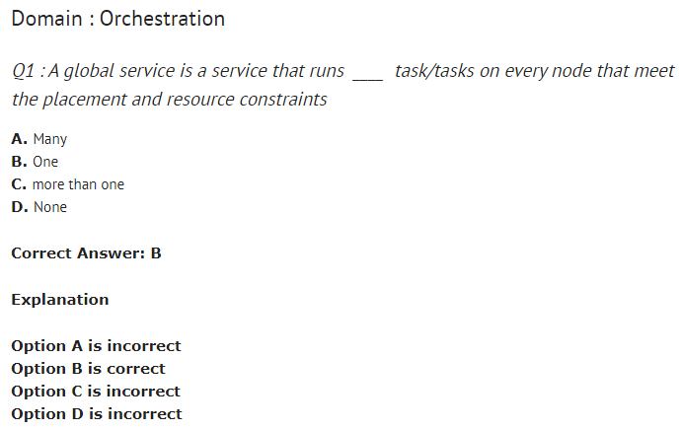
Docker Certified Associate

Slide 17
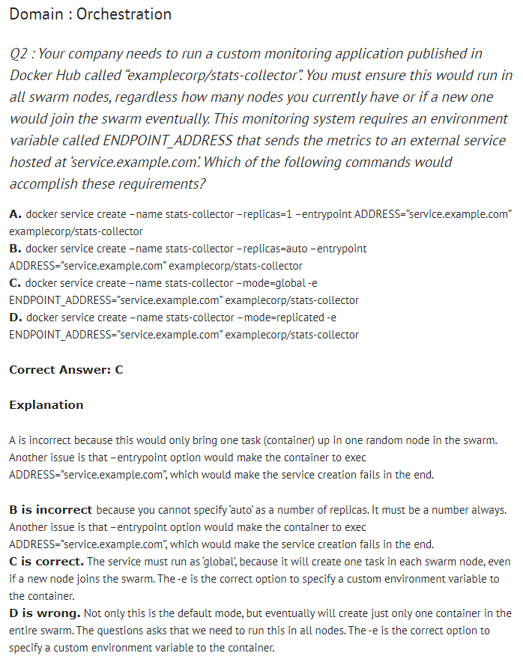
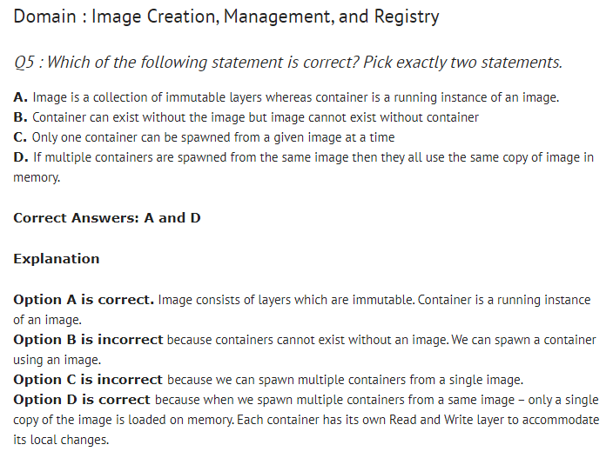

Slide 18
Kubernetes Certifications

Slide 19
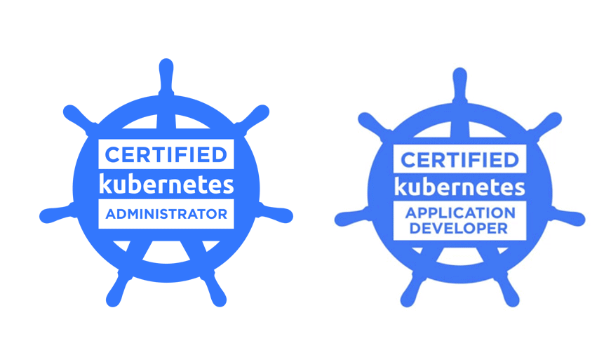
Kubernetes certifications

Slide 20
Kubernetes certifications
Kubernetes is an open-source container management system that automates the process of deploying and managing multi-container applications at scale.
Kubernetes paves the way for DevOps by enabling the team to keep pace with the requirements for software development, making it a power player in the world of DevOps certifications.
The Cloud Native Computing Foundation (CNCF) and the Linux Foundation collaborated to organize the Kubernetes certification program which validates professionals working on this software.
There are two certification options:
Certified Kubernetes Administrator (CKA)
Certified Kubernetes Application Developer (CKAD)

Slide 21
Certified Kubernetes Administrator (CKA)
The CKA program tests the skills, knowledge, and proficiency that a Kubernetes Administrator should possess.
The CKA exam is online and consists of a performance-based set of problems that the candidate must solve in a command line within three hours.
The test focuses on general Kubernetes features such as:
Application lifecycle management
Configuration
Installation and validation
Networking
Scheduling
Security
Logging and monitoring

Slide 22
Certified Kubernetes Application Developer (CKAD)
This CKAD certification is built for application developers that are looking to establish their credibility and expertise in the crowded market.
Candidates should be:
Skilled in designing, building, exposing, and configuring native cloud applications for Kubernetes.
Aware of application techniques for OCI-compliant container runtime, cloud native application concepts, infrastructure, and programming languages such as Python, Go, or Java.
This exam certifies a candidate’s experience, skills, application expertise, and familiarity with the Kubernetes environment.
It lasts two hours and covers core concepts, configuration, multi-container pod, observability, pod design, and services and networking.

Slide 23
Azure DevOps Certifications

Slide 24
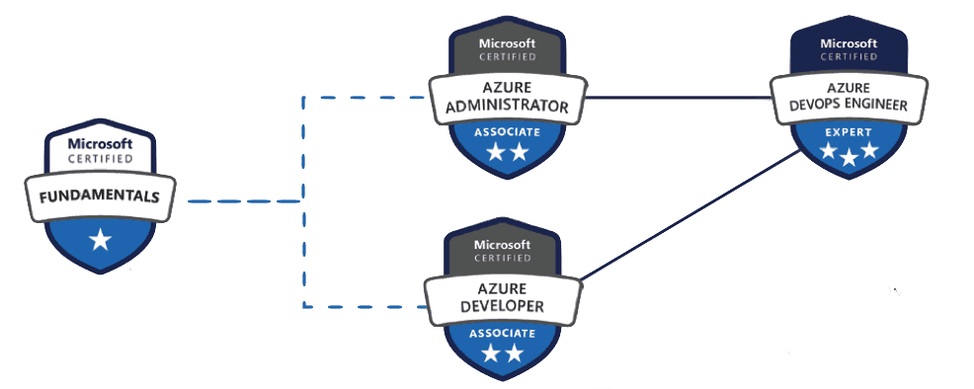
Azure DevOps Certification Path

Slide 25
Azure DevOps Engineer Expert
Microsoft Azure is a cloud computing service giant, competing with AWS and the Google Cloud Platform. It offers a wide variety of services, including web servers, email servers, databases, file storage servers, virtual machines, user directories, and more.
Incorporating Azure DevOps simplifies and speeds up the entire DevOps process, providing faster and more reliable deployments.

Slide 26
Azure DevOps Engineer Expert
Among the several Azure certifications, Azure DevOps Engineer Expert certification validates the skills and expertise of Azure DevOps professionals specifically.
Ideally, these Azure professionals will already be working as DevOps engineers, designing and implementing DevOps best practices for the version control, build, release, compliance, testing, and infrastructure as code by using Azure technologies.

Slide 27
Azure DevOps Engineer Expert
The AZ-400 exam for Microsoft Azure DevOps Solutions certification exam contains 40-60 multiple choice questions and covers concepts like:
Designing a DevOps strategy
Implementing DevOps development processes
Continuous integration
Continuous delivery
Application infrastructure
Dependency management
Continuous feedback

Slide 28
Puppet Certification

Slide 29
Puppet Certified Professional
The Puppet Certified Professional acknowledges talented candidates based on macro-level knowledge of Puppet IT automation software.
Ideal candidates should:
Know how to use the Forge to find and Apply modules
Be familiar with troubleshooting strategies for Puppet code and core Puppet platform components
Understand classification strategies and ways by which one can set class parameters and variables
Understand module testing practices, module structure, and design and arrangement of roles and profiles

Slide 30
Puppet Certified Professional
One of the top DevOps certifications is Puppet 206 – System Administration Using Puppet Exam.
This exam has 60 multiple choice questions with 90 minutes to answer.
Candidates can prepare for the Puppet Certified Professional certification by opting for Puppet Practitioner Instructor-led training sessions and the Puppet Enterprise Users Guide.

Slide 31
DevOps Institute Certifications

Slide 32
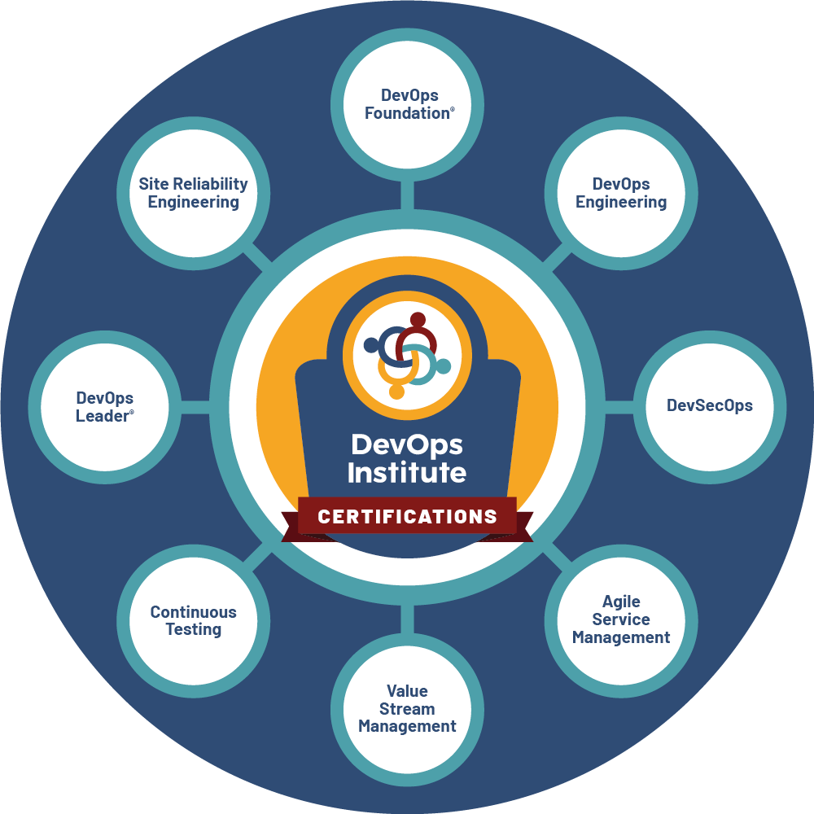
DevOps Institute

Slide 33
DevOps Institute
The DevOps Institute also offers multiple DevOps certifications that align with particular subsets of the DevOps methodology.
DevOps Foundation Certification provides a baseline understanding of key DevOps terminology to ensure everyone is talking the same language and highlights the benefits of DevOps to support organizational success
DevOps Leader (DOL) is a unique and practical experience for participants who want to take a transformational leadership approach and make an impact within their organization by implementing DevOps.

Slide 34
DevOps Institute
The DevOps Institute also offers multiple DevOps certifications that align with particular subsets of the DevOps methodology.
DevSecOps Foundation certification helps teams incorporate DevSecOps concepts to prevent data breaches while growing their knowledge in data privacy regulations, prioritizing compliance and security into daily workflows.
Continuous Testing Foundation aims to help practitioners produce faster releases of higher quality, all while reducing costs, minimizing risks, and improving the customer experience.

Slide 35
DevOps Institute
The DevOps Institute also offers multiple DevOps certifications that align with particular subsets of the DevOps methodology.
Certified Agile Process Owner (CAPO) dives into the process owner responsibilities so they can describe what they are doing as a process and provides the education needed to oversee the design, re-engineering and improvement of IT service management (ITSM) processes, particularly in the context of Agile service management.
Certified Agile Service Manager (CASM) introduces agile service management, the application, and integration of agile thinking into service management processes and process design projects.

Slide 36
DevOps Institute
The DevOps Institute also offers multiple DevOps certifications that align with particular subsets of the DevOps methodology.
Continuous Delivery Ecosystem Foundation equips professionals with the competencies required with orchestrating and architecting proficient deployment pipelines for the modern organization.
Site Reliability Engineering Foundation certification covers key concepts for improving service reliability, including SRE principles and practices; service level objectives and error budgets; monitoring and service level indicators; and SRE tools and automation.
DevOps Test Engineering (DTE) addresses testing in a DevOps environment and covers concepts such as the active use of test automation, testing earlier in the development cycle (shift left), and instilling testing skills in developers, quality assurance, security, and operational teams.

Slide 37
Importance of certifications for DevOps
As technology continues to evolve, so do companies, and regardless of their industry every company is becoming a technology company.
By obtaining one of these valuable DevOps certifications, engineers ensure not only that they remain competitive in their field, but that they remain ahead of the curve for both business and technology.

